Slide 1


ENHANCING VISIBILITY: TOOLS & STRATEGIES FOR NON-PROFIT ORGANISATIONS IN ATTRACTING OR RETAINING DONOR FUNDING
KCBI
KAPOTIVE
CAPACITY
BUILDING
INITIATIVE
ENHANCING VISIBILITY:
TOOLS & STRATEGIES FOR NON-PROFIT ORGANISATIONS IN ATTRACTING OR RETAINING DONOR FUNDING
Programe
ENHANCING VISIBILITY:
TOOLS & STRATEGIES FOR NON-PROFIT ORGANISATIONS IN ATTRACTING OR RETAINING DONOR FUNDING
PRESENTATION
INTRODUCTION

Slide 2

PRESENTATION
//SLIDE
INTRODUCTION
YOUR LOGO
WPS TEMPLATE
Visibility as a tool for organizations refers: To the deliberate efforts made by an organization to increase its presence and awareness among its target audience or stakeholders.
It involves strategies and actions aimed at making the organization more recognizable, prominent, and accessible to the public, supporters, donors, partners, and other relevant stakeholders. The visibility can manifest in various forms include.

Slide 3
Conti…
YOUR LOGO
PRESENTATION
//SLIDE
WPS TEMPLATE
Brand Visibility
Online Visibility
Media Visibility
Event Visibility
Partnership Visibility and
Visibility through Advocacy and Thought Leadership.
Overall, visibility as a tool for organizations involves proactive efforts to increase awareness, recognition, and engagement, ultimately contributing to the organization's success in achieving its mission and goals. Lets dig in at different forms of visibility:

Slide 4
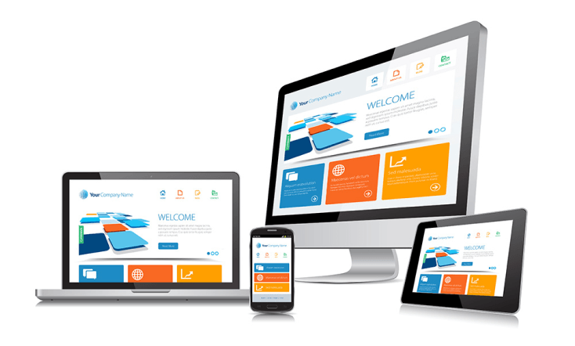
01. Websites: Quality and Effectiveness
PRESENTATION
//SLIDE
A website is a collection of interlinked web pages that share a single domain name and serve various purposes. These web pages are usually made available online by an individual, company, educational institution, government, or organization. Websites contain hyperlinks that connect them to each other, allowing users to navigate between different pages.
Presentations are communication tools
ENHANCING VISIBILITY TOOLS & STRATEGIES FOR NON-PROFIT ORGANISATIONS IN ATTRACTING OR RETAINING DONOR

Slide 5
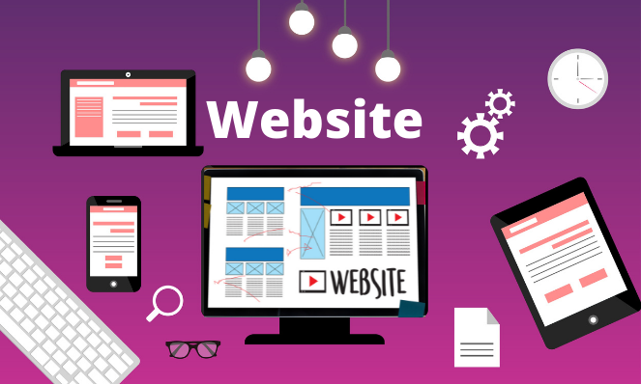
Reasons as why we need websites for our Organizations
PRESENTATION
//SLIDE
Increased Visibility and Accessibility.
Market Expansion.
Diversified Revenue Streams.
Availability 24/7.
Customizable Advertising:
Building Trust.
Brand Building.
New Marketing Opportunities.
Presentations are communication tools
ENHANCING VISIBILITY TOOLS & STRATEGIES FOR NON-PROFIT ORGANISATIONS IN ATTRACTING OR RETAINING DONOR

Slide 6
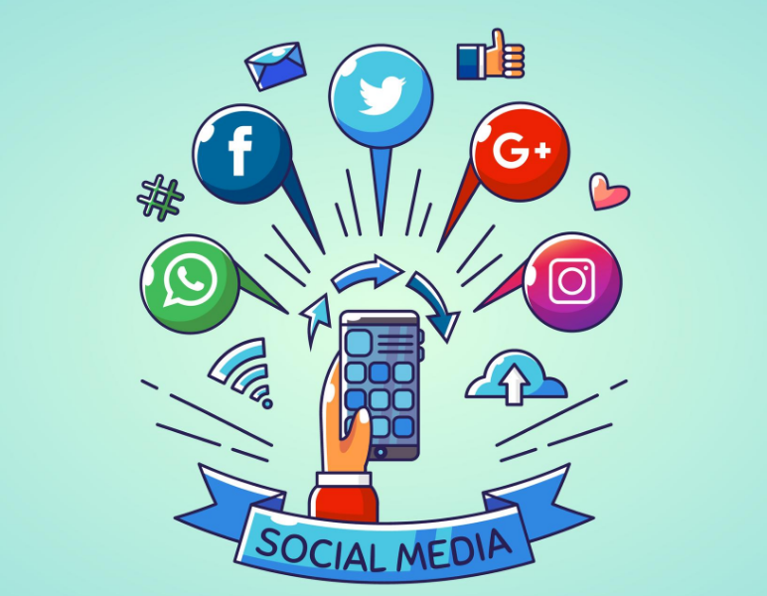
02. Social media: Content creation and outreach.
PRESENTATION
//SLIDE
This involves ideating, designing, producing, and sharing visual and textual assets across various platforms to engage with the target audience. Its primary aim is to boost visibility, foster engagement, and achieve specific marketing objectives, thereby empowering your social media presence.
Presentations are communication tools
ENHANCING VISIBILITY TOOLS & STRATEGIES FOR NON-PROFIT ORGANISATIONS IN ATTRACTING OR RETAINING DONOR

Slide 7

Importances of Social Media towards retaining Donors
PRESENTATION
//SLIDE
Certainly! Social media marketing plays a pivotal role in today’s digital landscape. Let’s explore its importance and the benefits it towards attracting and retaining donors:
Increases Organization Brand Awareness.
Cost-Effective.
Gain Customer Trust.
Interact with Target Audiences.
Presentations are communication tools
ENHANCING VISIBILITY TOOLS & STRATEGIES FOR NON-PROFIT ORGANISATIONS IN ATTRACTING OR RETAINING DONOR

Slide 8
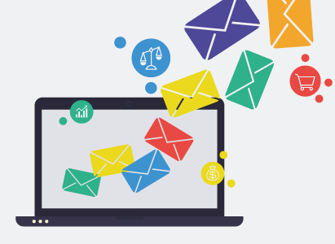
03. Email Campaigns
PRESENTATION
//SLIDE
An email campaign is a strategic sequence of marketing emails sent to multiple recipients.
These campaigns are designed to reach subscribers at the right time, providing valuable content and relevant offers.
Presentations are communication tools
ENHANCING VISIBILITY TOOLS & STRATEGIES FOR NON-PROFIT ORGANISATIONS IN ATTRACTING OR RETAINING DONOR

Slide 9
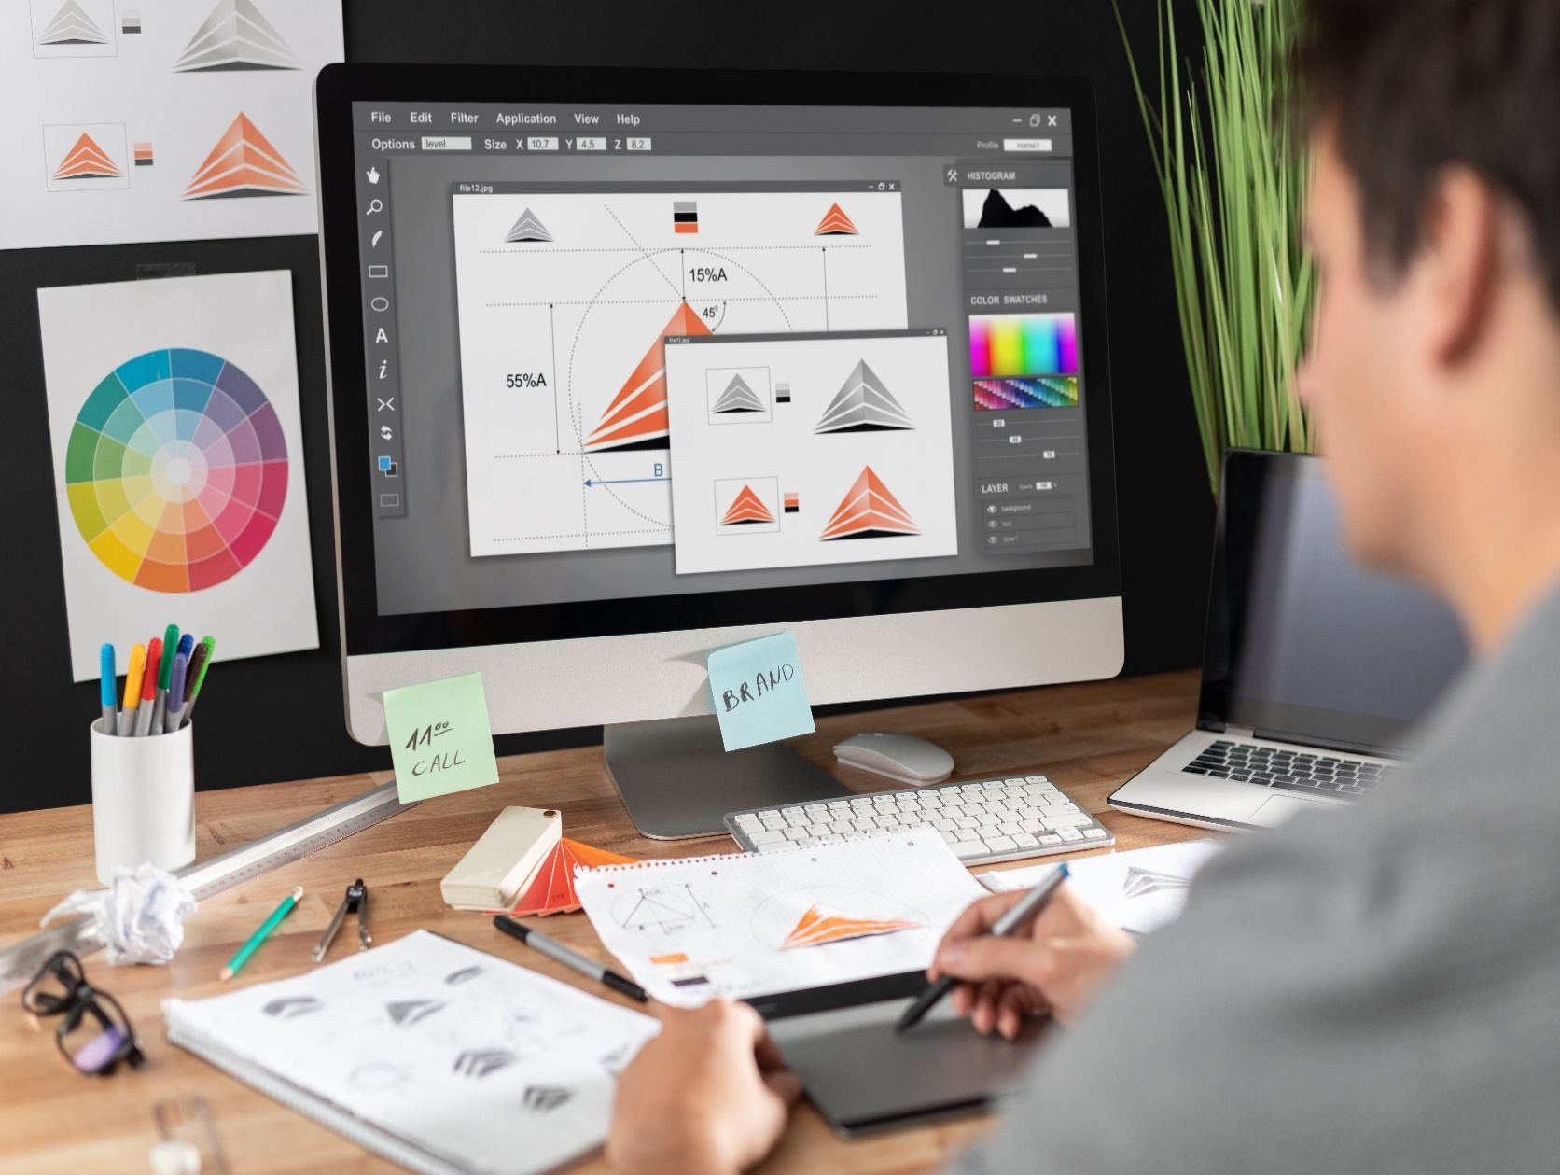
04. Documentaries and Graphics
PRESENTATION
//SLIDE
Certainly! Graphics play a crucial role in visual communication, design, and artistic expression. Let’s explore some aspects related to graphics:
Graphic design is the art of creating visual content to convey messages, ideas, or information.
Designers use typography, images, colors, and layout principles to communicate effectively.
Logos, posters, brochures, and social media graphics are examples of graphic design.
Presentations are communication tools
ENHANCING VISIBILITY TOOLS & STRATEGIES FOR NON-PROFIT ORGANISATIONS IN ATTRACTING OR RETAINING DONOR

Slide 10
Examples
PRESENTATION
//SLIDE
WEBSITES:
https://www.kolpingtanzania.or.tz/
https://www.protech.co.tz
https://www.elctbukobahotelandtours.com
https://www.kioo.or.tz
https://www.tasiwa.or.tz
https://www.elctnwd.or.tz
http://www.mavunoproject.or.tz/
Presentations are communication tools
ENHANCING VISIBILITY TOOLS & STRATEGIES FOR NON-PROFIT ORGANISATIONS IN ATTRACTING OR RETAINING DONOR

Slide 11
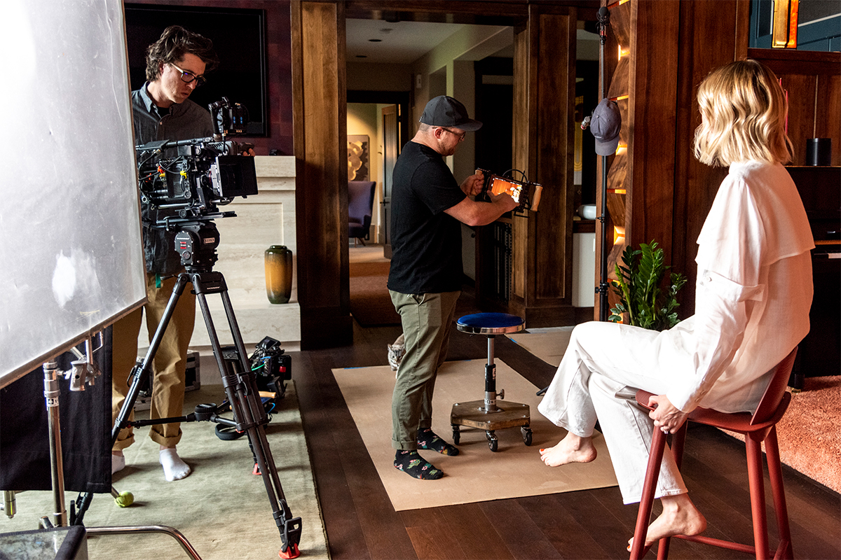
05. Video Documentaries
PRESENTATION
//SLIDE
https://www.youtube.com/watch?v=qFeK5RGeQy4&t=29s
https://www.youtube.com/watch?v=-vRKgUmLXB8
https://www.youtube.com/watch?v=Xbj-2a36BPc&t=68s
https://www.youtube.com/watch?v=y0_FUnrfV38&t=2s
Presentations are communication tools
ENHANCING VISIBILITY TOOLS & STRATEGIES FOR NON-PROFIT ORGANISATIONS IN ATTRACTING OR RETAINING DONOR

Slide 12
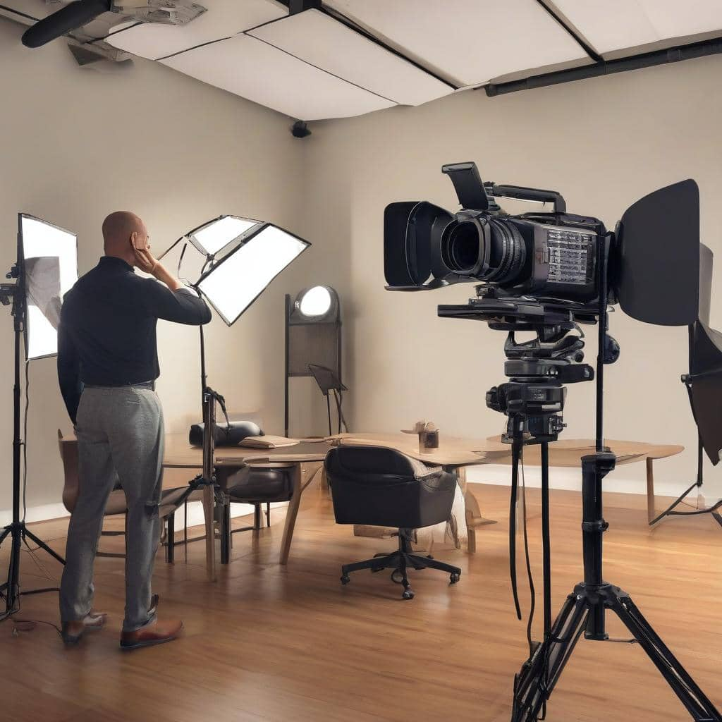
www.kapotive.or.tz
Tel: +255 767 047 621
Tel: +255 711 326 789
Whatsapp Link
https://chat.whatsapp.com/LqosgEAG6no4qY2RaRPqe2

